Slide 2


PRESENTED BY

Slide 3


Slide 4
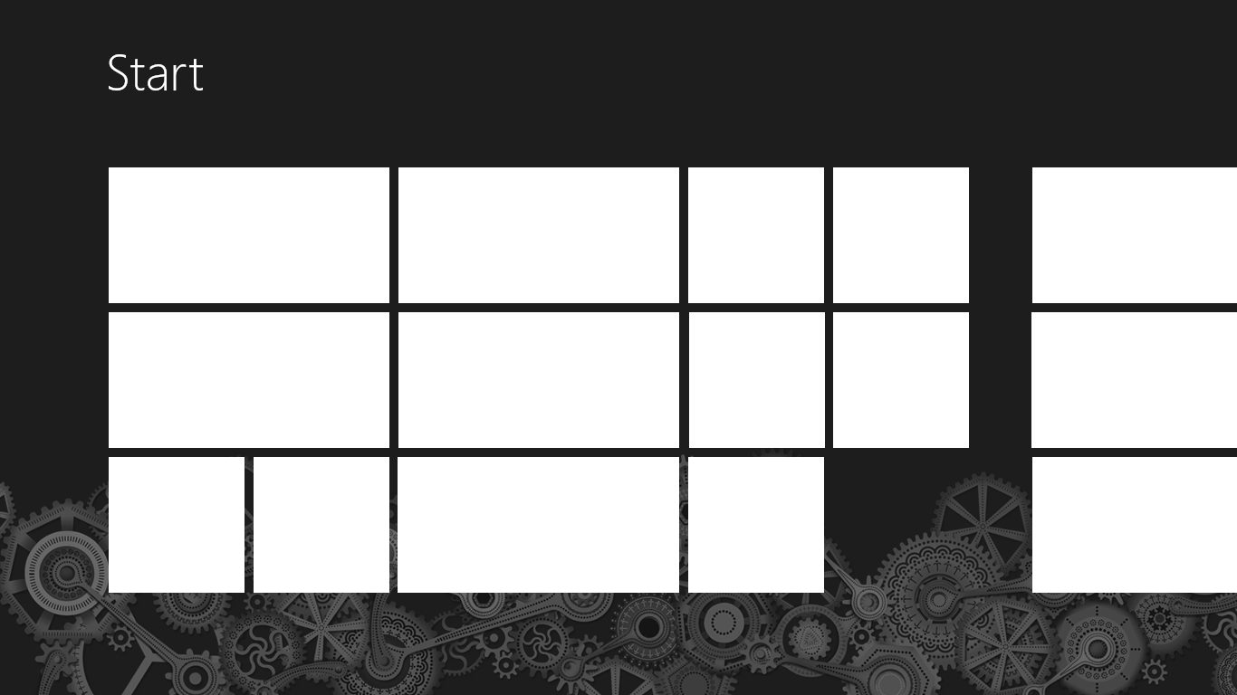




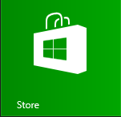
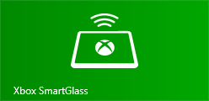

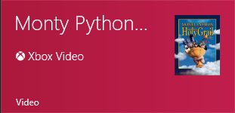
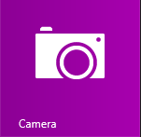


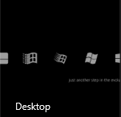

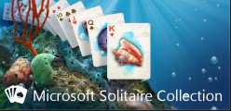
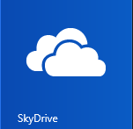

Lwin
Maung
Min Maung
I fixed the code on the site. Good
to go.

Clark Sell
Is this thing live?
29

Microsoft
Microsoft Event Reminder
Thank you for your interest in Microsoft
One Day One Track, That C…
.NET Rocks!
Harper College
9:00 AM – 6:00 PM
Clark Sell
Did you update the
website?
Greg Lev…
Is your blog site live yet?
Saturday



1
99⁺


Slide 5

Tiles, Toast, Share, Settings, Roam...
Lwin Maung
@lmaung
 lwin@maungs.com
 www.pressffive.com
Managing Director, Accolade Systems

Slide 6
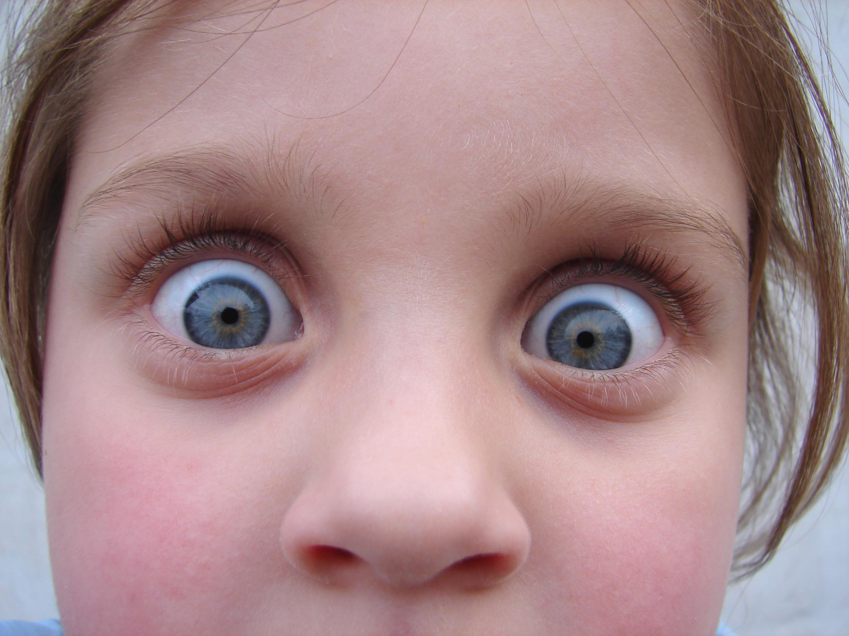
Notes:
Show you ways to go WOW
Easy 5-10 lines of code

Slide 7

Infortainment universe
Notes:
Sheer amount of information intake is mind blowing

Slide 8
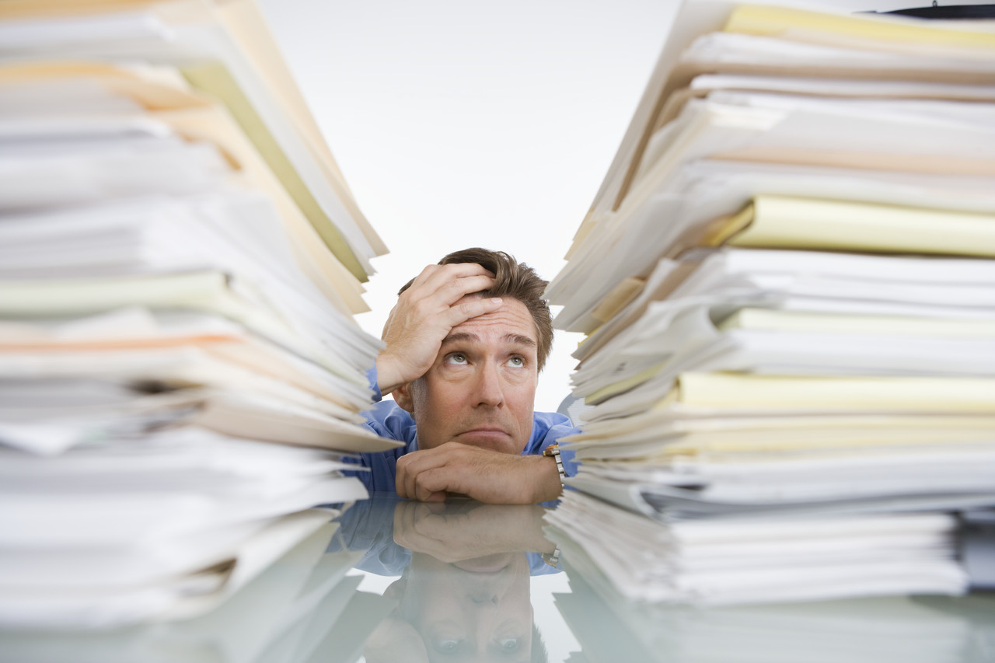
Change in volume
Notes:
Sheer amount of information intake is mind blowing

Slide 9
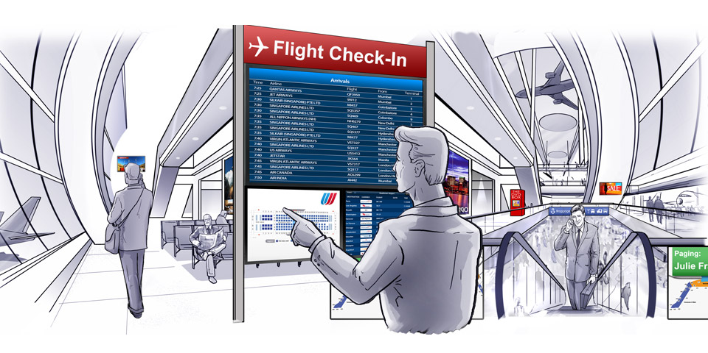
Delivery of information
Notes:
Show you ways to go WOW
Easy 5-10 lines of code

Slide 10
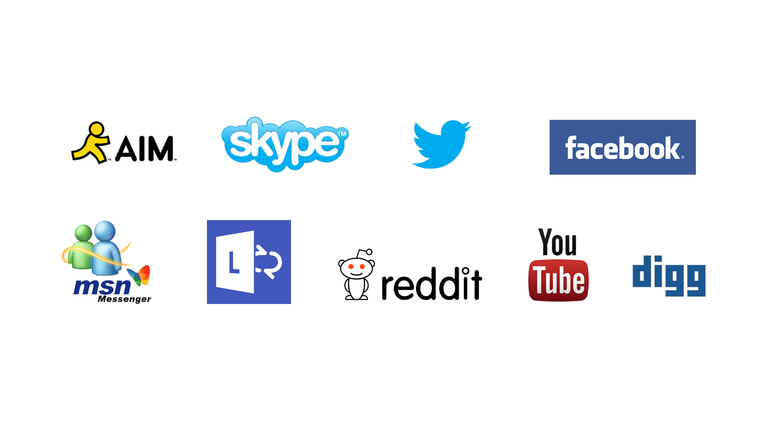
Social interactions
Notes:
Pros and cons of social networks for apps

Slide 11

Hunger for infotainment
Notes:
We’re all guilty
Armstrong thru facebook.

Slide 12
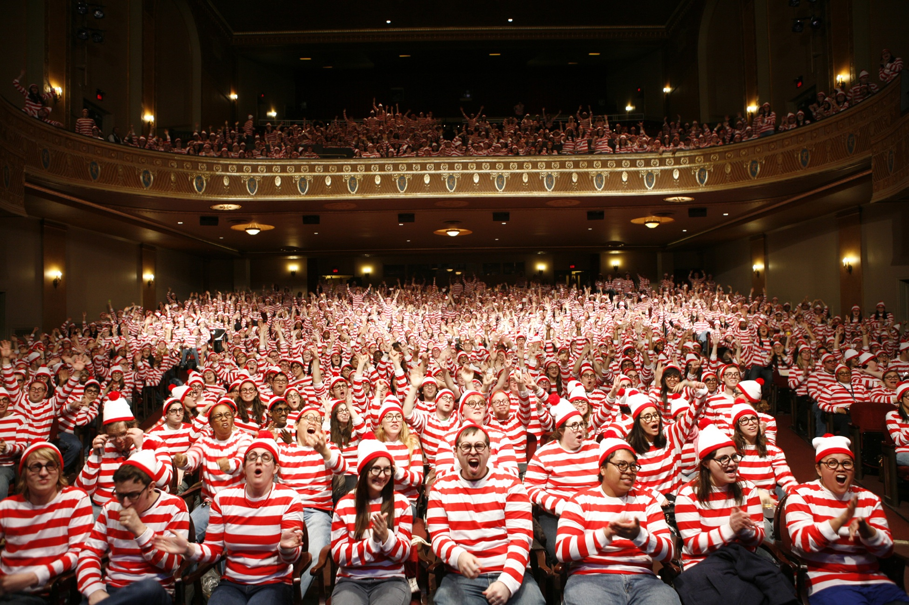

Slide 13


Slide 14

Plays well with others

Slide 15

Be heard

Slide 16

Sharing is caring

Slide 17

Be where YOU want to be…

Slide 18

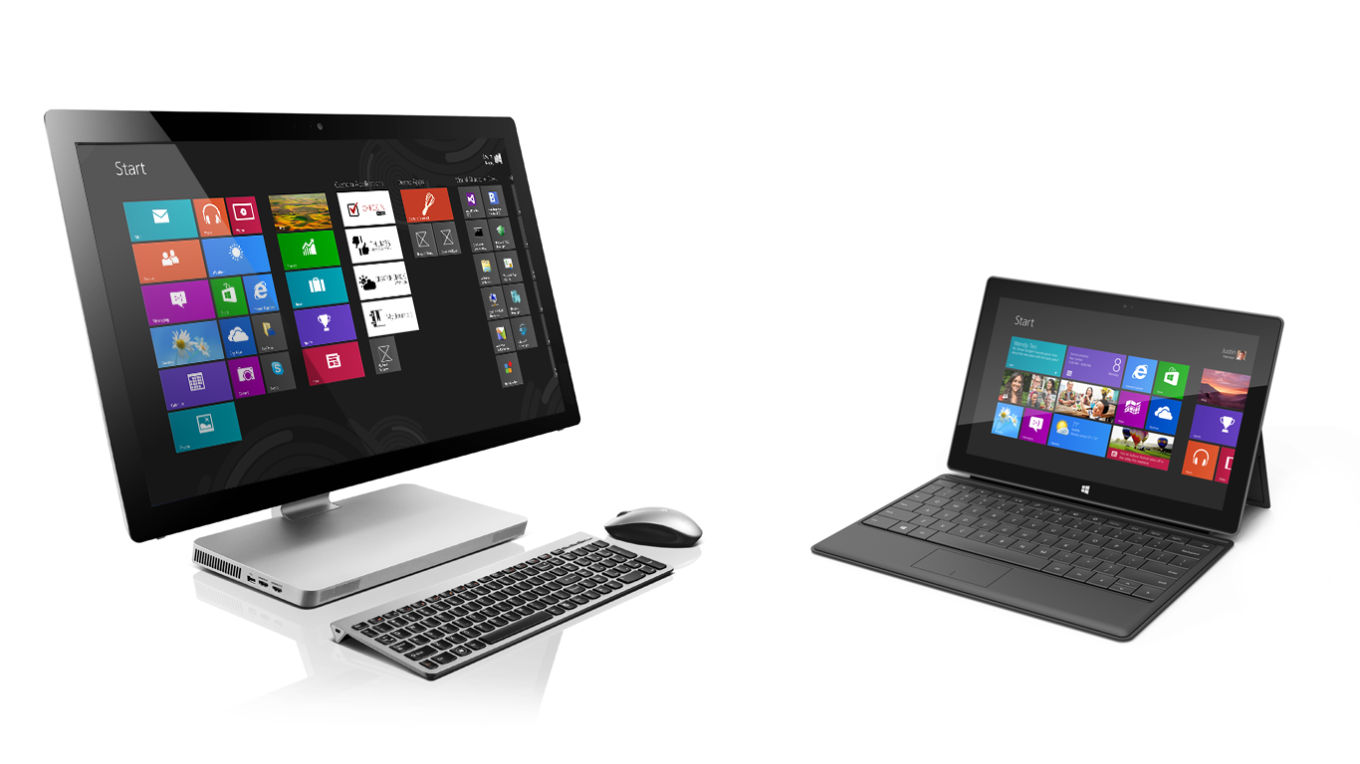

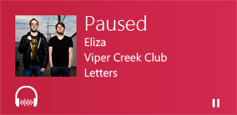

MAKE SURE YOU TALK ABOUT ROAMING

Devices

Slide 20
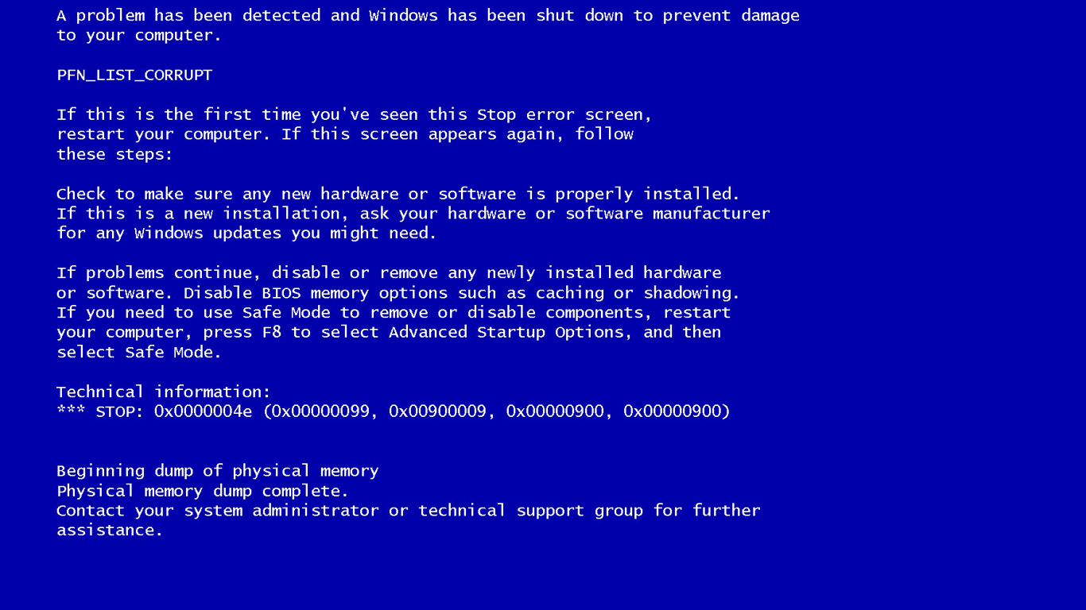

Slide 21
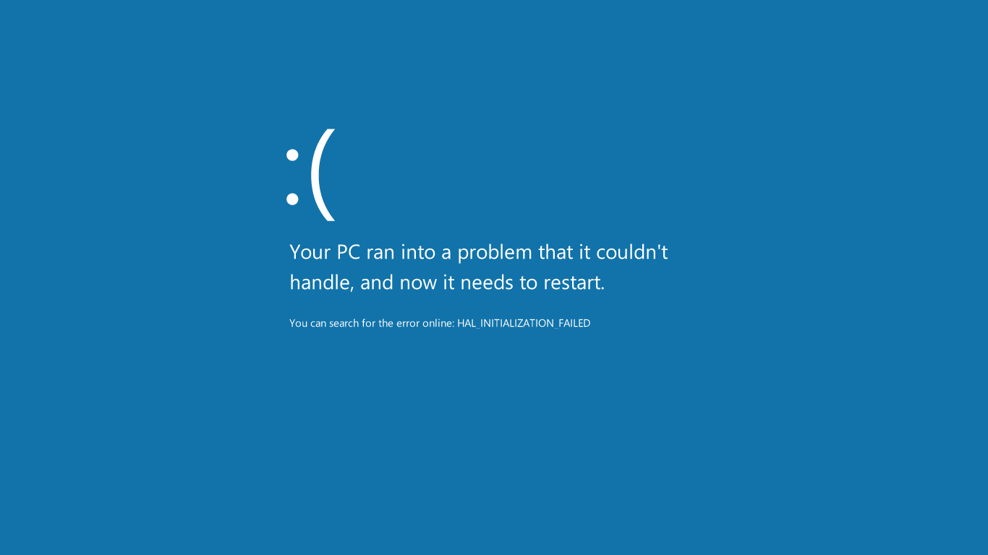

Slide 23


Now, let me show you how…

Slide 24

This is not about…

Slide 25
<grid> abc </grid>
private void UpdateTile
{
string tileXmlString = ". . ." ;
Windows.Data.Xml.Dom.XmlDocument tileDOM = new Windows.Data.Xml.Dom.XmlDocument();
tileDOM.LoadXml(tileXmlString);
TileNotification tile = new TileNotification(tileDOM);
TileUpdateManager.CreateTileUpdaterForApplication()
.Update(tile);
}

Slide 26
<html> abc </html>
private void UpdateTile
{
var tileXmlString = ". . ." ;
var tileDOM = new Windows.Data.Xml.Dom.XmlDocument();
tileDOM.loadXml(tileXmlString);
var tile = new Windows.UI.Notifications.TileNotification(tileDOM);
Windows.UI.Notifications.TileUpdateManager.
createTileUpdaterForApplication().update(tile);
}

Slide 28
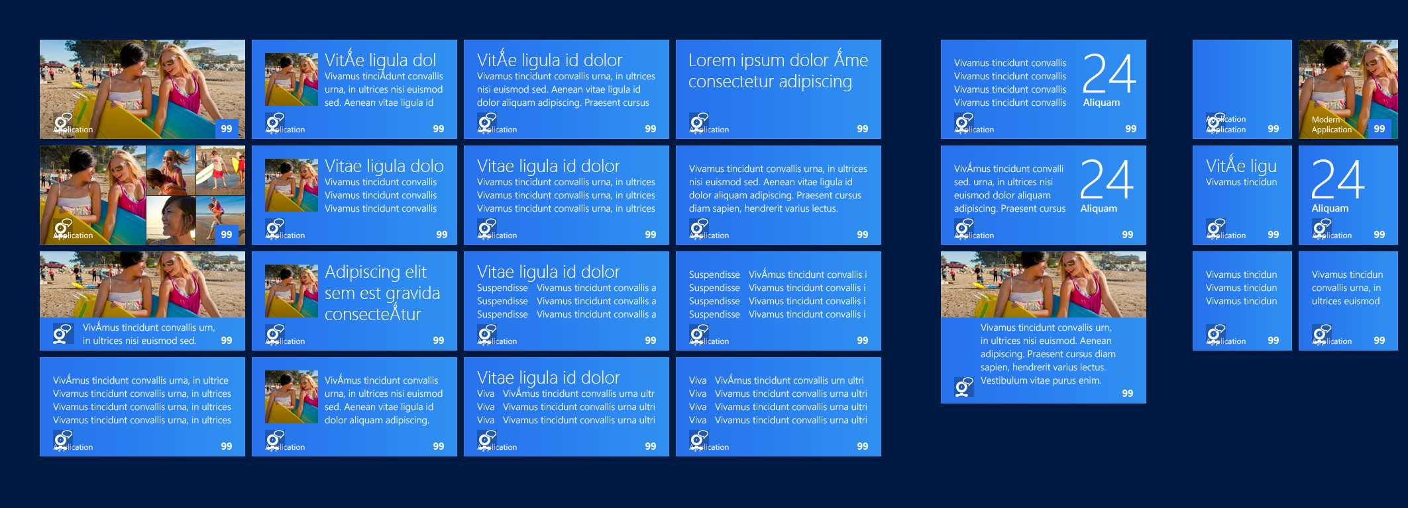
Tile Templates
Photo templates for photo apps, social apps.
Date related scenarios, calendar, events
Text variations for mail, stocks etc,
New square templates for live tiles
Multi-purpose template for image+ text scenarios like news articles
Great for social apps, square user photos

Slide 29
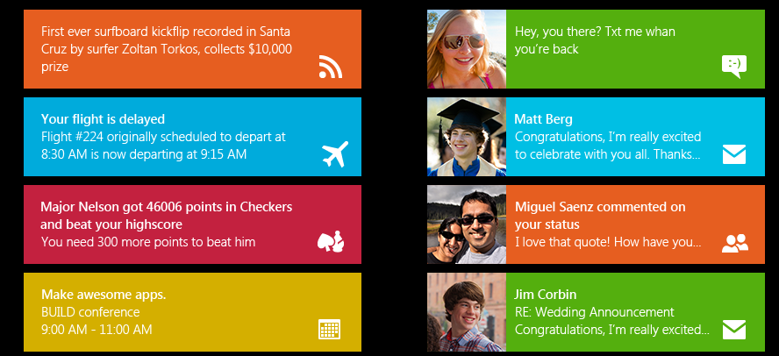
Notifications templates

Slide 30
User Data vs. App Data
User data
Documents
Photos
Music
Videos
App data
Settings
Files
Session State
Local Cache

Slide 31


App Data CAN Roam
App uses data normally
Local
Storage
Data syncs for the user’s Microsoft account

Slide 32


Slide 33
Lwin
Maung
29
Microsoft
Microsoft Event Reminder
Thank you for your interest in Microsoft
One Day One Track, That C…
.NET Rocks!
Harper College
9:00 AM – 6:00 PM
Clark Sell
Did you update the
website?
Greg Lev…
Is your blog site live yet?
Saturday



1
99⁺


